Slide 1
Object Oriented
Analysis and Design
ICT2142
Sandaruwani Pathirage
Dept. of ICT
Faculty of Technology
University of Ruhuna

Slide 2

LECTURE 06:
Activity Diagrams

Slide 3
Objectives
After successful completion of this lecture, students should be able to:
  Identify the notations in activity diagrams.
  Draw activity diagrams for the given scenarios.

Slide 4
Introduction
Activity diagrams are “OO flowcharts”
  Can show both data flow & control flow
Allow to model a process as a collection of activities and
transitions between those activities.
Activity diagrams are particularly useful for process modeling, behavior visualization, requirement analysis, process
improvement, and communication among stakeholders.
Notes:
The main purpose of an activity diagram is to model the flow of activities and actions within a system or process.

Slide 5
Introduction
The elements of an activity diagram are,
  action nodes
  control nodes
    Initial and final (final nodes have two varieties, activity final and flow final)
    Decision and merge
    Fork and join
  object nodes

Slide 6
When to use Activity Diagrams?
Activity diagrams model flows of actions, decisions, and
control logic.
Activity diagrams can illustrate how actions are distributed
across actors or components using swimlanes

Slide 7
Activity Diagram Notations

Slide 8
Activity
An activity represents a behavior composed of one or more actions.
Activities consist of a network of nodes connected by edges.
Nodes can be action nodes, control nodes, or object nodes.
  Action nodes represent executable steps.
  Control nodes manage the flow of execution (e.g., decisions, forks).
  Object nodes represent objects or data used within the activity.
Edges represent paths or flows of execution between nodes.
Every activity begins with an initial node and ends with a final node.

Slide 9
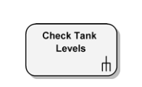
Actions
Actions are the fundamental units of behavior in an activity diagram.
Actions are represented as rounded rectangles.
An action’s label may be written in plain English or pseudo-code.
When written in English, the label should be a verb or verb phrase, since actions denote something being performed.

Slide 10
Actions are,
  Atomic – An action is not decomposed within the
  activity; it is treated as a single step.
  Uninterruptible – Once an action begins execution, it
  runs to completion.
  Instantaneous – An action is assumed to take
  negligible time relative to the overall activity.

Slide 11

Action Flow
Also called as edges and paths.
Illustrate the transitions from one action state to another.

Slide 12
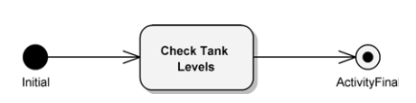
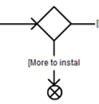
Starting & Stopping
The initial node (starting point of an activity) is
represented by a solid filled circle.
The activity final node (termination of the entire activity) is represented by a bull’s-eye symbol (filled circle inside an outer circle).
A flow final node is represented by a circle containing an “X”.
The flow final node terminates only the specific flow
reaching it, without ending the entire activity.

Slide 13
Decision & Merge Nodes
Decision and Merge nodes are represented by a
diamond shape.
These nodes control alternative flows within an activity.
Two types:
  Decision node
  Has one incoming flow and multiple outgoing flows.
  Each outgoing flow is guarded by a condition (guard).
  Only one path is selected at runtime.
  Merge node
  Has multiple incoming flows and one outgoing flow.
  Combines alternative paths without synchronization.
  Any one incoming flow can continue execution.

Slide 14
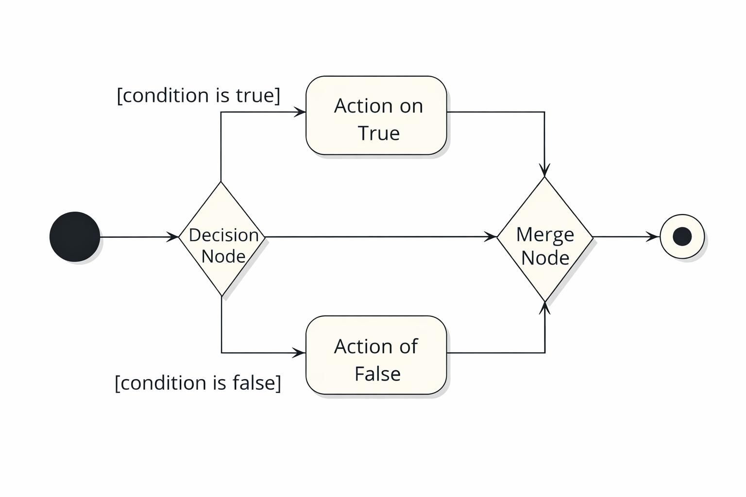
Decision & Merge Nodes

Slide 15
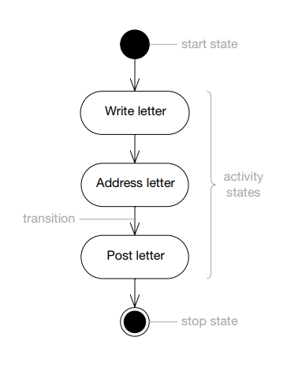
Exercise 1
Draw the activity diagram for posting a letter using
the given actions.
  Actions
    Write letter
    Address letter
    Post letter

Slide 16
Exercise 2
The activity starts with “Get mail” action.
When this state finishes its work, If the mail is junk mail, then [is junk] evaluates to true, then go into the state Bin mail, and then to the stop state.
Otherwise, go into the state Open mail, and then to the stop state.

Slide 17
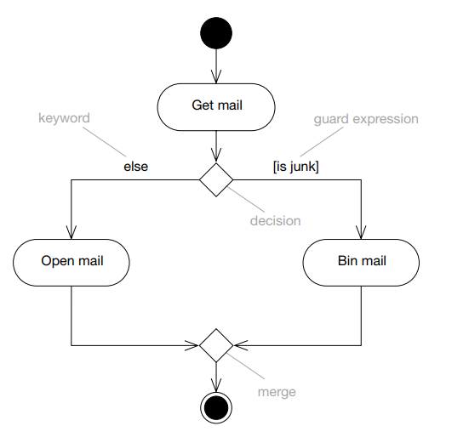
Exercise 2 - Answer

Slide 18
Partitions/swimlanes
Elements in an activity diagram can be organized using partitions (also called swimlanes).
A partition indicates responsibility for performing actions within the activity.
In a business model, partitions may represent:
Business units
  Departments or divisions
  Business actors or roles
  Organizations
In system modeling, partitions may represent:
  Systems
  Subsystems
  External systems
In application modeling, partitions may represent:
  Objects
  Components
  Logical entities within the application

Slide 19
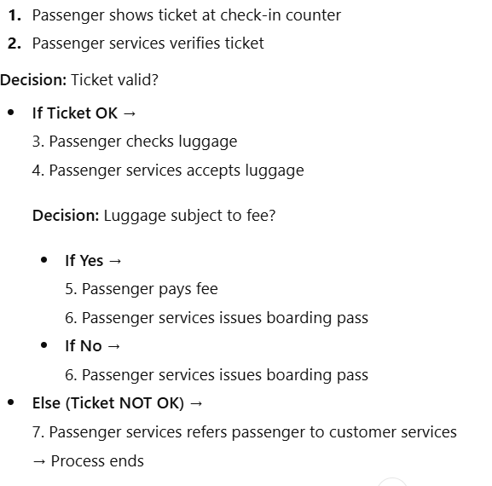
Partitions - Example
Actions in the Diagram

Slide 20
Partitions - Example
How Swimlanes Are Determined
Swimlane: Passenger
Actions performed by the passenger:
Showing ticket at check-in counter
Checking luggage
Paying fee
These are user / actor behaviors.
Swimlane: Passenger Services
Actions performed by airline staff/system:
Verifying ticket
Referring passenger to customer services
Accepting luggage
Issuing boarding pass
These are service / system responsibilities.

Slide 21
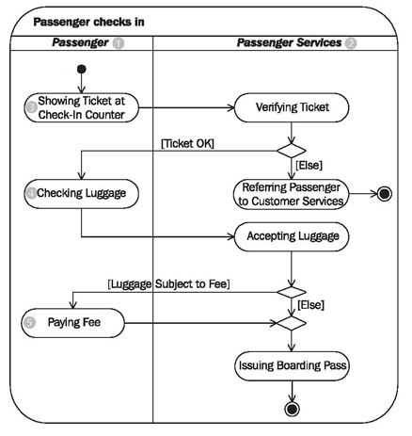
Partitions - Example

Slide 22
Forks & Joins
Concurrent threads.
Activity diagrams support modeling of concurrent flows of
execution.
Concurrency represents activities that can proceed in
parallel.
A fork node is used to split one flow into multiple concurrent flows.
A join node is used to synchronize concurrent flows back into a single flow.

Slide 23
Forks & Joins
Fork and join nodes are analogous to decision and merge
nodes, respectively.
The critical difference is concurrency.
Forks have one flow in and multiple flows out, as do decision nodes.
The difference is, where a decision node selects a single
outbound flow, a single flow into a fork results in multiple
outbound flows which occur concurrently.

Slide 24
Forks & Joins
All the outbound flows occur concurrently.
A join has multiple incoming flows and a single outbound
flow, similar to merge nodes.
With a join, all the incoming flows must be completed
before the outbound flow begins.

Slide 25
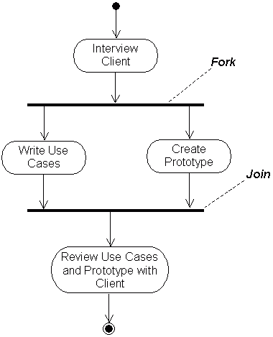
Forks & Joins - Example

Slide 26
Object Flow
Object flow refers to the creation and modification of objects
by activities.
An object flow arrow from,
  An action → object
    The action produces, creates or updates the object.
  An object → action
    The action uses, reads, or requires the object.
You should only show the important objects on an object flow.

Slide 27
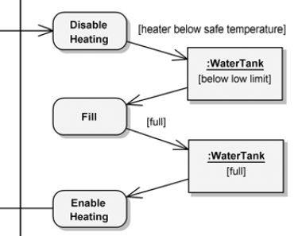
Object Flow
You can show the object’s state, by writing the name of the state in square brackets below the object’s
Name.

Slide 28
Exercise 3
Draw an activity diagram that represents the workflow of creating a document using a word processing package. This goes through the following steps:
Open the word processing package.
Create a file.
Save the file under a unique name within its directory.
Type the document.
If graphics are necessary, open the graphics package, create the graphics, and paste the graphics into the document.
If a spreadsheet is necessary, open the spreadsheet package, create the spreadsheet, and paste the spreadsheet into the document.
Save the file.
Print a hard copy of the document.
Exit the word processing package.

Slide 29
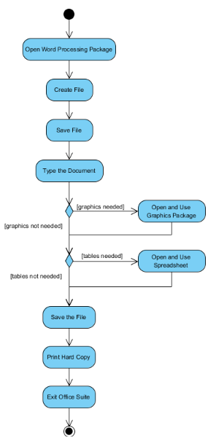
Exercise 3

Slide 30
Exercise 4
Draw the activity diagram of order processing.
Requested order is the input parameter of receiving the order.
If the order is accepted, all required information is filled in, the
invoice is sent and then the payment is accepted.
When the payment is accepted, the order is shipped.
Note, that this business flow allows order shipment during
sending the invoice and confirmation of payment actions.
Finally, the order is closed.

Slide 31
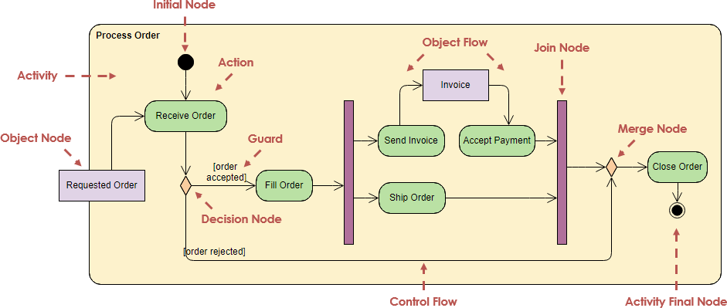
Exercise 4

Slide 32
Exercise 5
A company follows a structured process when engaging with prospective clients.
The process starts when a sales person contacts a client to schedule an appointment. Depending on the appointment arrangement, different preparation activities occur:
For onsite meetings, a corporate technician prepares the meeting facilities.
For offsite meetings, a consultant prepares the required equipment.
After the necessary preparation is completed, the consultant meets with the client.
Following the meeting, the sales person sends a follow-up letter.
If the client provides a statement of the problem, the consultant creates a proposal and sends it to the client.
If the client does not provide a problem statement, the process ends.
Construct a UML activity diagram representing this workflow.
Notes:
In your scenario, the client:
✔ Does not perform modeled actions
✔ Only triggers conditions (e.g., provides statement of problem)
✔ Acts as an external participant

Slide 33
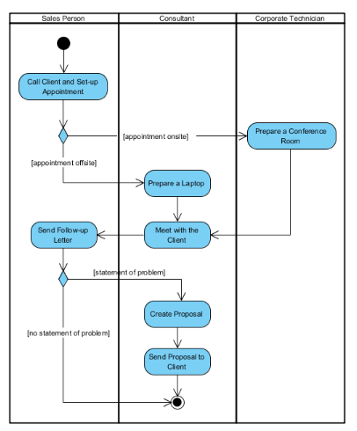
Exercise 5

Slide 34
THANK YOU!

